Slide 1
Balloon Survivor
Project Presentation

Slide 2


Balloon Survivor
a game that u need to survive

Slide 3
Balloon Survivor
a game that u need to survive
Temple Run
Temple Run is a 2011 endless running video game developed and published by the Raleigh -based Imangi Studios.

Slide 4
Balloon Survivor
a game that u need to survive
A mobile application that aims to be a game that is easy to play and easy to install. And most of all, the game can be played anytime and anywhere.

Slide 5
Balloon Survivor
a game that u need to survive
TOOLS

Slide 6
Balloon Survivor
a game that u need to survive
PhoneGap
PhoneGap is a free and open source framework that allows you to create mobile apps using standardized web APIs for the platforms you care about.

Slide 7
Balloon Survivor
a game that u need to survive
HTML5
HTML5 is a core technology markup language of the Internet used for structuring and presenting content for the World Wide Web.

Slide 8
Balloon Survivor
a game that u need to survive
Accelerometer
Accelerometers in mobile phones are used to detect the orientation of the phone. An accelerometer measures linear acceleration of movement, while a gyro on the other hand measures the angular rotational velocity. Both sensors measure rate of change; they just measure the rate of change for different things. In practice, that means that an accelerometer will measure the directional movement of a device but will not be able to resolve its lateral orientation or tilt during that movement accurately unless a gyro is there to fill in that info

Slide 9
Balloon Survivor
a game that u need to survive
FEATURES
* Play
* Game Over
* Replay
* Evasion through mobile tilting
* Collision of balloon w/ other objects
* Point scoring

Slide 10

Balloon Survivor a game that u need to survive
PLAY

Slide 11
Balloon Survivor a game that u need to survive
Evasion through
mobile tilting
Collision of
Balloon w/ other
objects

Slide 12
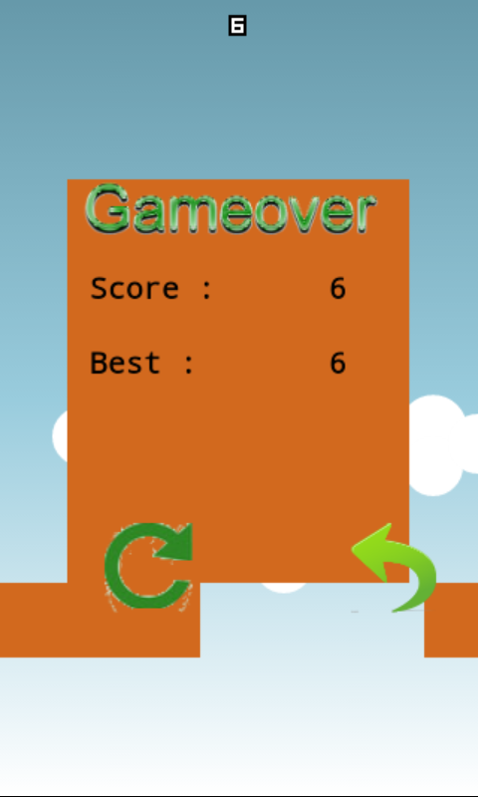
Balloon Survivor a game that u need to survive
Game Over
Replay

Slide 13


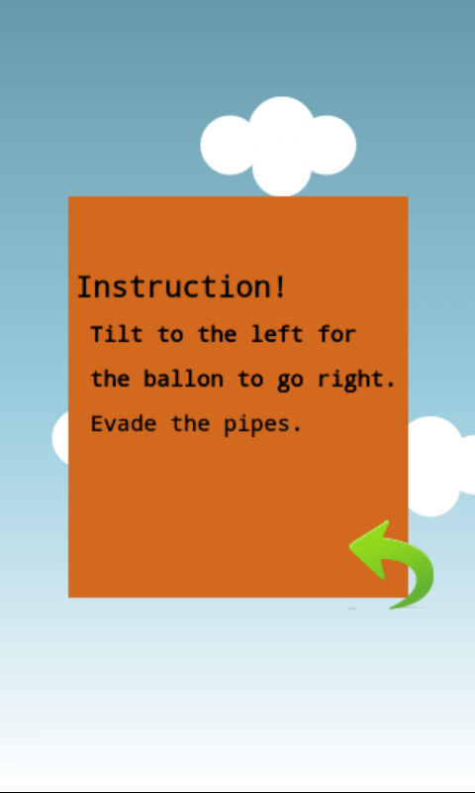

Balloon Survivor a game that u need to survive
Add-Ons

Slide 14
Balloon Survivor
a game that u need to survive
Methods of Implementation
* How to move the balloon
* How collision affects
* How to aim for a highest score

Slide 15
Balloon Survivor
a game that u need to survive
How to move the balloon
- Accelerometer
- Left tilt goes left
- Right tilt goes right

Slide 16
Balloon Survivor
a game that u need to survive
How collision affects
- x and y coordinates determination
- objects except for pipes
=> (game proceeds)
- collision with pipes
=> (game over)

Slide 17
Balloon Survivor
a game that u need to survive
How to aim for the highest score
- envade the pipes
- every pipe corresponds to one point mark
- survive

Slide 18
Balloon Survivor
a game that u need to survive
Play,
Survive,
and Experience!!!
Anytime, Anywhere!!!!!!!
BALLOON SURVIVOR

